Slide 1
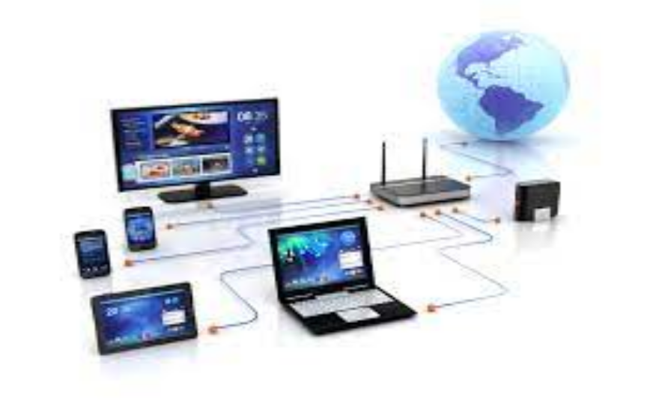
Unit 2.1 - Computer Networks
Prepared by: Koh Kian Hua

Slide 2
Objectives (Part 1)
After completing this unit, students should be able to:
Understand the purpose and benefits of networking devices
Understand the characteristics of a LAN (local area network)and a WAN (wide area network)
Explain the client-server and peer-to-peer models of networked computers, their roles, benefits and drawback of each model, and how they are used in a given situation.
Understand the use of thin-client, thick-client and their differences.

Slide 3
Computer Networks
History of Computer Networks
Started in the 1970s when the ARPANet (Advanced Research Projects Agency Network) was used to connect a large number of computers in the US Department of Defense.
It later expanded to include university computers.

Slide 4
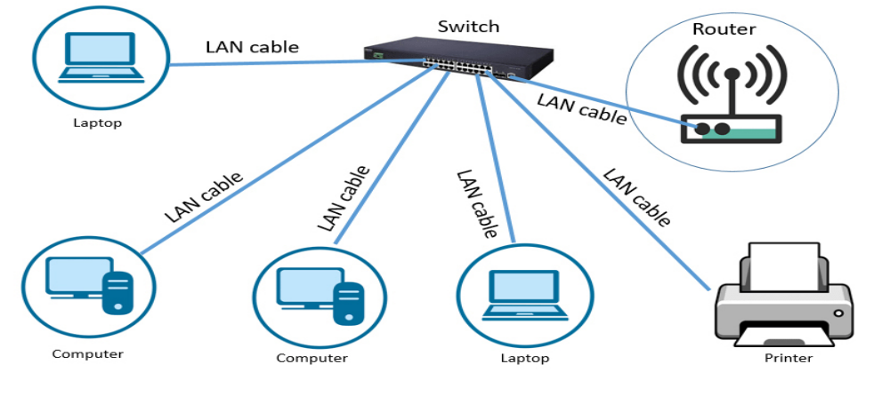
Computer Networks
Types of Neworks
Local Area Network (LAN): Refers to network covering a small area such as a single building connecting a number of computers and shared devices, such as printers.

Slide 5
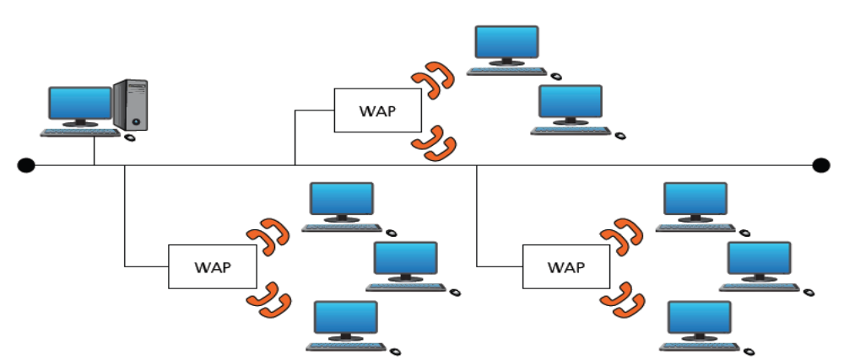
Computer Networks
Types of Neworks
Wireless LAN (WLAN): A wireless computer network that links two or more devices using wireless communication to form a local area network within a limited area such as a home, school, computer laboratory, campus, or office building. WLAN often has wireless access points (WAPs), are connected into the wired network at fixed locations.

Slide 6
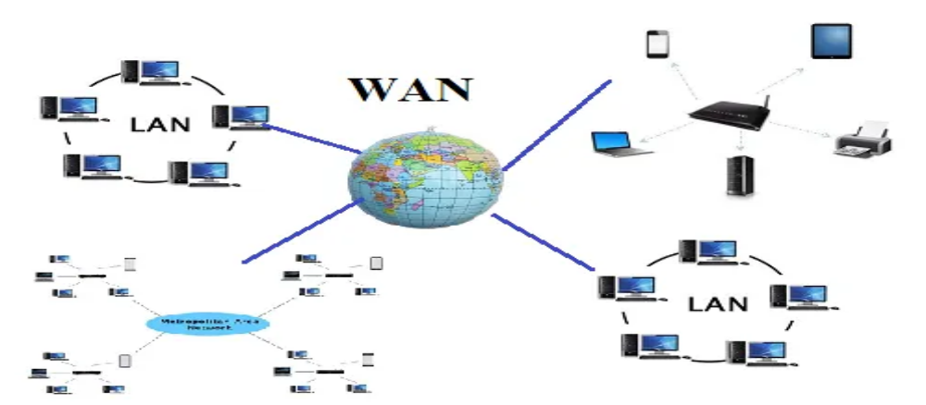
Computer Networks
Types of Neworks
Wide Area Network (WAN): Network covering a very large geographical area and typicaly consist of a number of LANs connected via public communications networks (such as telephone lines or satellites). Automated teller machines (ATMs) used by banks is one of the most common examples of the use of a WAN.

Slide 7
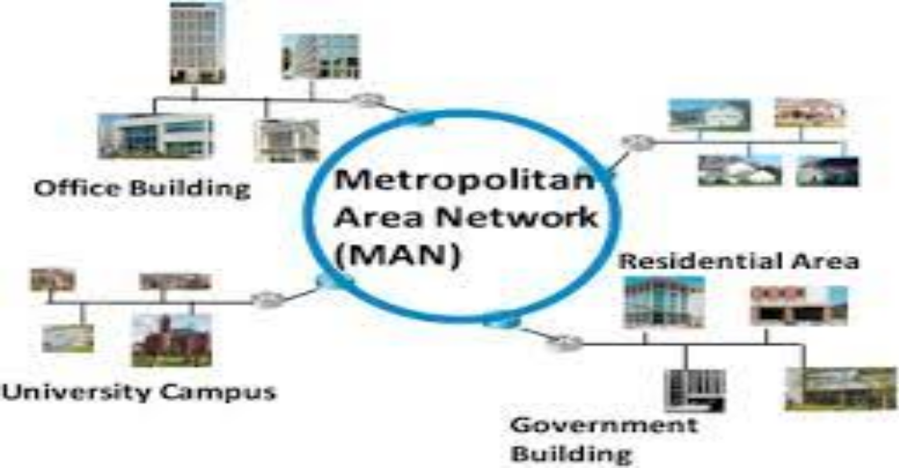
Computer Networks
Types of Neworks
Metropolitan Area Network (MAN): Larger than LANs and can connect together many LANs housed in different buildings within a city such as a university campus. MANs are restricted in their size geographically (eg: a single city).

Slide 8
Computer Networks
Components for Networked Computers
Hardware
LAN cards
routers
switches
wireless routers
cabling
Software
operation and management of the network
operation of firewalls
security applications/utilities
Services
DSL (Digital Subsciber Line)
satellite communication channels
wireless protocols
IP addressing.

Slide 9
Computer Networks
Two Categories of Neworks
Private Networks: A private network is any network to which access is restricted. A corporate network or a network in a school are examples of private networks. The organization is responsible for the purchase of their own equipment and software and maintenance of the network
Public Networks: A type of network wherein anyone, namely the general public, has access and through it can connect to other networks or the Internet. It is normally operated by a telecommunications agency, or a recognized private operating agency, for the specific purpose of providing data transmission services for the public.

Slide 10
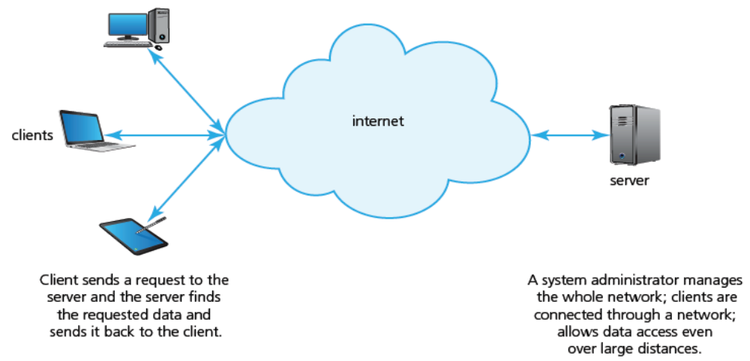
Computer Networks
Types of Neworking Models
Client-Server Model: model uses separate dedicated servers and specific client workstations; client computers will be connected to the server computer(s). Users are able to access most of the files, which are stored on dedicated servers.

Slide 11
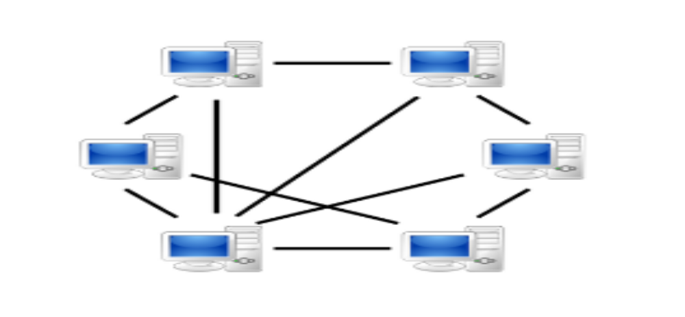
Computer Networks
Types of Neworking Models
Peer to Peer Model: A decentralized communications model in which each party has the same capabilities. The peer-to-peer model does not have a central server. Each of the workstations on the network can share its files with all the other workstation, and each of the workstation will have its own data. The model offers little data security since there is no central security system. This means it is impossible to know who is authorised to share certain data.

Slide 12
Computer Networks
Client Server Model
Characteristics of Client-Server model
Uses separate dedicated servers and specific client workstations;
Client computers will be connected to the server computer(s).
Users are able to access most of the files, which are stored on dedicated servers.
The server dictates which users are able to access which files.
The client-server model allows the installation of software onto a client’s computer.
The model uses central security databases which control access to the shared resources.
Client-server networks can be as large as you want them to be and they aren much easier to scale up than peer-to-peer networks.
This model offers the most stable system, for example, if someone deletes a shared resource from the server, the nightly back-up would restore the deleted resource
Client-server networks can become bottlenecked if there are several client requests at the same time.

Slide 13
Computer Networks
Client Server Model
Reasons for choosing Client-Server model
The company/user normally has a large user-base
Access to network resources needs to be properly controlled.
There is a need for good network security.
The company requires its data to be free from accidental loss (eg: data needs to be backed up at a central location).

Slide 14
Computer Networks
Peer to Peer Model
Characteristics of Peer to Peer model
Each node (computer) joins the network to allow:
The provision of services to all other network users; the services available are listed on a nominated ‘look up’ computer
Other users on the network to simply access data from another node
Communication with other peers connected to the network
Peers to be both suppliers and consumers
Peers to participate as equals on the network
There is little data security in peer to peer networks since there is no central security system.

Slide 15
Computer Networks
Client Server Model
Reasons for choosing Peer to Peer Model
The network of users is fairly small.
There is no need for robust security.
They require workstation-based applications rather than being server-based.

Slide 16
Computer Networks
Pros and Cons (Client-Server Vs Peer-to-Peer)
Client-Server | Peer-to-Peer
Files are all located on the server so backing up is a lot easier than backing up each individual computer separately. | Each computer needs to have its files managed individually – Backing up can take longer.
Anti-virus software is managed centrally. All computers are protected as files are managed in one place. | Each computer must have it’s virus software updated individually. If managed poorly, it could result in some computers not being up to date.
Most of the processing occurs centrally, this means clients have more processing power available. | Processing is shared amongst computers which could result in slower performance, especially if lots of computers are trying to use the services of one computer at the same time.

Slide 17
Computer Networks
Pros and Cons (Client-Server Vs Peer-to-Peer)
Client-Server | Peer-to-Peer
Data and applications are available to any client connected, provided they have access rights. | The user has to use the same computer each time in order to work on their files.
Security is managed centrally and securely. | Security can be ‘ad-hoc’ meaning some users may have access to printers and files and other might not.
Software can be installed quickly across a network from the central server. | Software must be installed on each machine separately which takes up a lot of human resource time.
Servers are very costly due to their large processing power, huge storage capability and memory. They also tend to need to be stored in an air conditioned room. | All the computers can run normally, sharing resources only when requested. This is a very cheap way to run a network.

Slide 18
Computer Networks
Pros and Cons (Client-Server Vs Peer-to-Peer)
Client-Server | Peer-to-Peer
If a server fails then the entire network is unable to operate. | If a single computer goes down then the remaining computers are unaffected. They may lose the ability to print if the computer controlling the printer is the computer that goes down...but the printer can be connected to another machine if required.
Network managers are required to run this type of network – this can be quite costly. | A reasonably competent user of ICT can set up a P2P network. The use of in-built wizards in most operating systems has made this even easier.
If applications are run from the server it can cause lots of network traffic thus slowing down the network. | Network traffic is minimal as most tasks are carried on the individual computers.

Slide 19
Computer Networks
Thin Clients and Thick Clients
The client-server model can be configured as
thin clients
thick clients
Thin Clients: PCs that connect remotely into a separate server or data
center that does all the work in a virtual environment. Thin
Clients has to constantly connect to a server in order to
work properly (eg: web browser is a thin client software)
Thick Clients: Full featured computers with all the standard hardware and
locally installed operating system and applications.

Slide 20
Computer Networks
Differences Between Thin and Thick Clients
Think Client Software | Thick Client Software
Always relies on a connection to a remote server or computer for it to work | Can run some of the features of the software even when not connected to a server
Requires very few local resources (such as SSD, RAM memory or computer processing time) | Relies heavily on local resources
Relies on a good, stable and fast network connection for it to work | More tolerant of a slow network connection
Data is stored on a remote server or computer | Can store data on local resources such as HDD or SSD

Slide 21
Computer Networks
Class Activity
Describe three advantages of networking computers.
What is the main difference between a client-server and a P2P network?
Describe two disadvantages of a client-server network.

